Slide 1


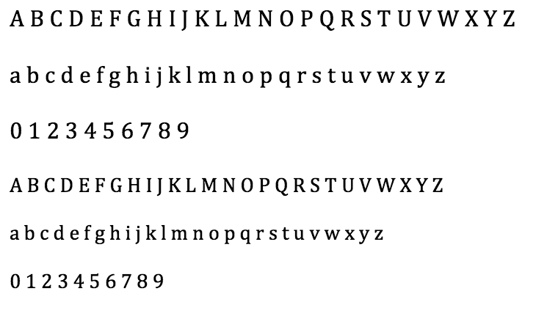

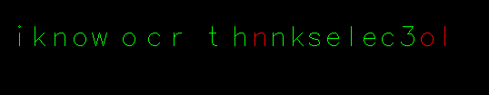

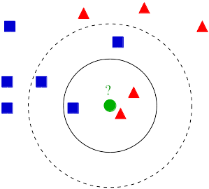
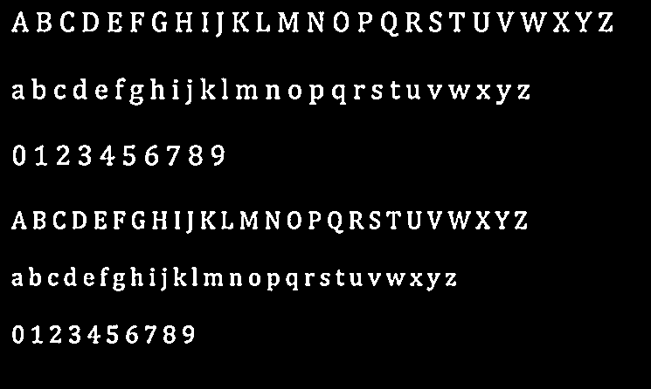
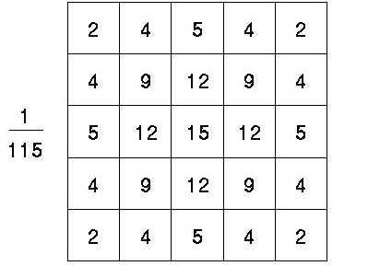
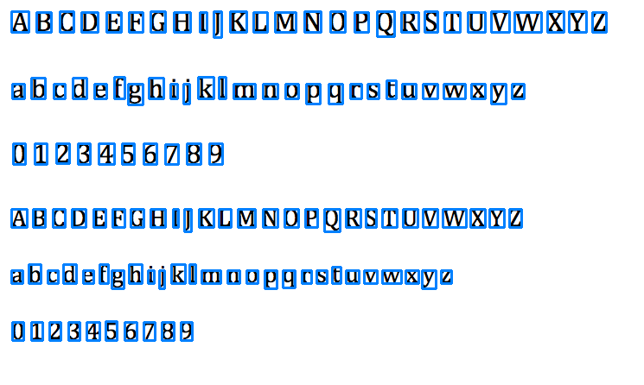

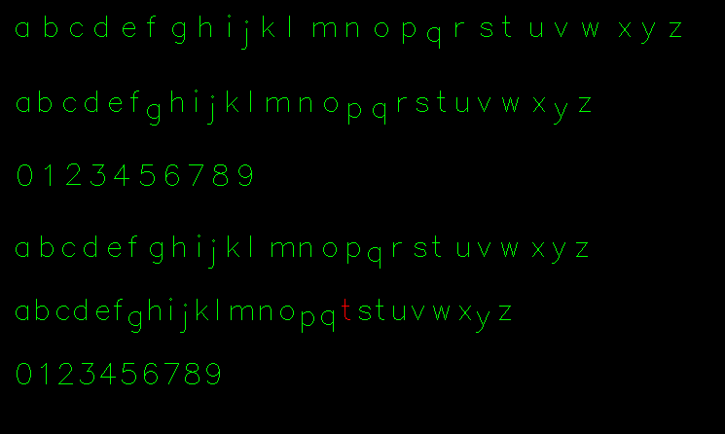

Introduction to Optical Character Recognition
Xin Huang, Raul Martinez, Leo Meister, Jonathan Nguyen
Why Make a Tutorial?
Training Data
Conclusion
Optical character recognition (OCR), has been extensively researched and documented
Lack of a fully comprehensive step-by-step guide to using OpenCV
Further expand our knowledge and contribute to the open source community
Provide basic insight to beginners to OCR in the field of text-based character recognition
Multiple fonts and sizes
Intensity values as features
Added more data for similar characters to improve recognition
Achieved ~85% accuracy using simple features
Achieved 10% greater accuracy with the Gaussian blur than without
Produced an easy-to-follow tutorial providing experience in Python and OCR
Soon to be released on Connexions
Gaussian Blur
Algorithms
Eliminates high-frequency noise that may result in false edges
K-Nearest Neighbors (k=1)
Image filtering – convolve intensity matrix by filter
Future Work
Thresholds
Include how to find and use a greater variety of features for better accuracy
Incorporate more techniques (SVM instead of KNN, MSER regions)
Use it on pictures of text instead of screenshots
Learn more in ELEC 345 and improve upon algorithms
Calculates gradient using adaptive thresholding
Compares to threshold value
Contour
Illustration of KNN (k=3)
Gaussian filter
Find edges based on gradient
Outline the edges on input image
Resize each bounding rectangle to a 10x10 matrix of intensity values
References
OpenCV
Open Source Computer Vision Library: opencv.org
Experimented with a variety of techniques
Settled on bounding rectangles over Canny edge detection
K-Nearest Neighbors (KNN) over Support Vector Machine (SVM)
Introduction to edge detection: http://dasl.mem.drexel.edu/alumni/bGreen/www.pages.drexel.edu/_weg22/can_tut.html
Recognition
Acknowledgements
Compares intensity vectors against training results
Uses k-nearest neighbors
Green characters are matches
Red characters are misses
Special thanks to Dr. Richard Baraniuk, Chris Metzler, and Vivek Boominathan.

